Slide 1
ST Engineering | Project Harmony | AI for Operations Demo Storyboard
Accenture | Palantir
Prototype storyboard based on Palantir supply chain demo
Re-framed for STE Civil Aviation MRO and Operations Research priorities
Notes:
Purpose of this deck:
• Provide an ST Engineering-aligned story and talk track using the same interaction patterns seen in the Palantir demo.
• Focus on two priority decision products: (1) C-check readiness and critical spares actions, (2) Component Services and MBH revenue assurance exceptions.
• This is a storyboard. The pixel-level UI remains the source demo screen capture, with demo panels removed to maximise workspace.

Slide 2
Demo scenarios
Accenture | Palantir
Scenario 1 | C-check readiness: critical spares and replanning (single site MVP)
Scenario 2 | Component Services + Maintenance-by-the-Hour: revenue assurance and component pool actions
Common capabilities reused: Ontology navigation, alert triage, explainable causal graph, what-if simulation, action write-back with approvals.
Notes:
Narrator:
We will use two connected scenarios. Both use the same underlying software patterns: an ontology-backed operational cockpit, an alert queue, an investigation workspace, and action execution with approvals.
The first scenario is site-level readiness for one hangar. This matches the Part 1 hypothesis.
The second scenario shows how component services and MBH rules can move from Excel to governed logic with revenue assurance and faster decisions.

Slide 3
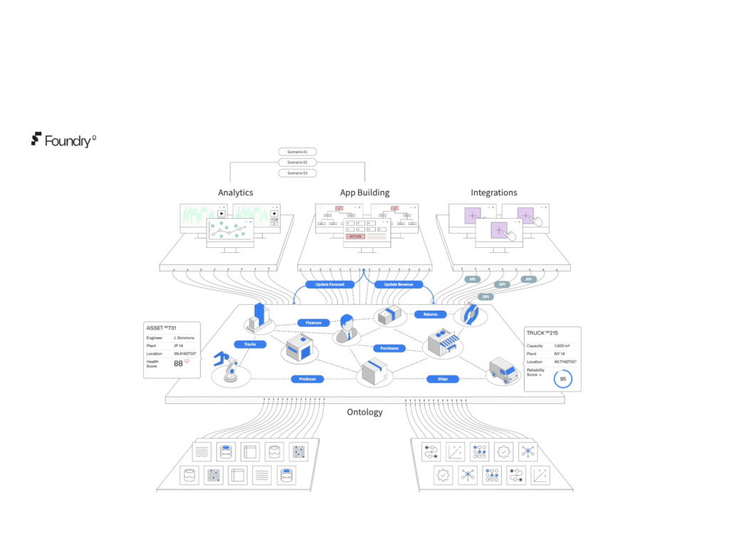
Scenario 1 | C-check readiness and critical spares
Accenture | Palantir
Notes:
Screen reference: original demo frame 0014
Talk track:
This is the operating model we are targeting. Data from SAP and shop-floor sources is unified into an ontology of aircraft events, parts, work orders, suppliers, and locations.
Operators do not open 10 systems. They start from the decision and drill into the evidence. Actions write back to SAP with full audit.

Slide 4
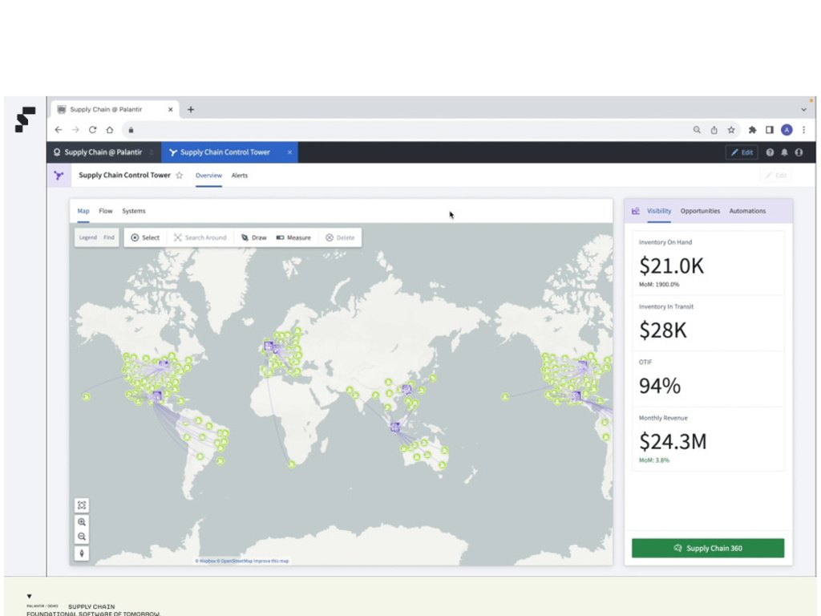
Scenario 1 | C-check readiness and critical spares
Accenture | Palantir
Notes:
Screen reference: original demo frame 0020
Talk track:
We start in an ST Engineering MRO Operations Control Tower.
The decision owner is the site operations lead and the material planner lead. Cadence is daily with intra-day exceptions.
This view combines hangar slots, active checks, critical part readiness, and predicted delivery risk.
Key KPIs: on-time induction, on-time redelivery, critical part availability at need date, and schedule adherence by hangar.

Slide 5

Scenario 1 | C-check readiness and critical spares
Accenture | Palantir
Notes:
Screen reference: original demo frame 0021
Talk track:
We start in an ST Engineering MRO Operations Control Tower.
The decision owner is the site operations lead and the material planner lead. Cadence is daily with intra-day exceptions.
This view combines hangar slots, active checks, critical part readiness, and predicted delivery risk.
Key KPIs: on-time induction, on-time redelivery, critical part availability at need date, and schedule adherence by hangar.

Slide 6
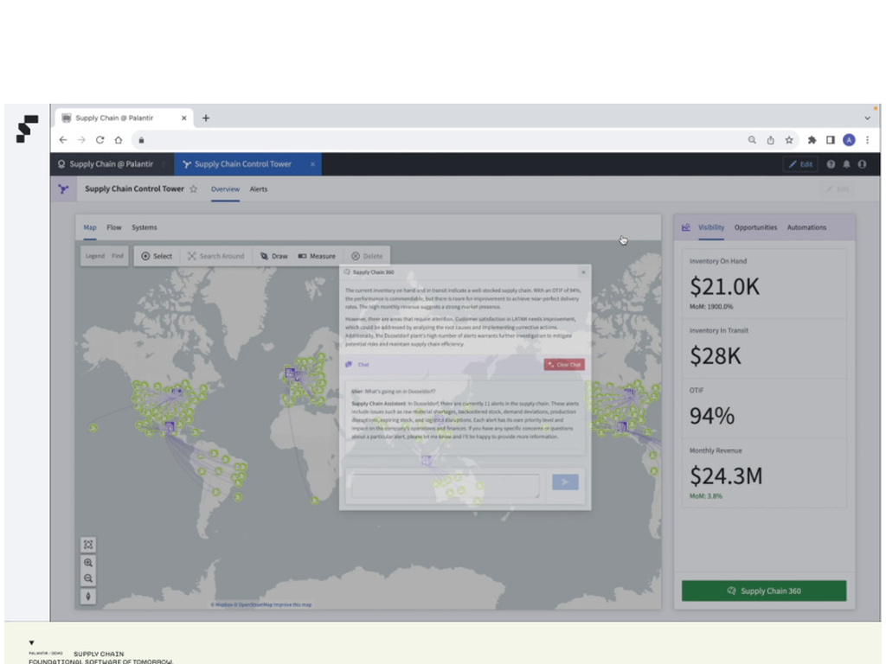
Scenario 1 | C-check readiness and critical spares
Accenture | Palantir
Notes:
Screen reference: original demo frame 0032
Talk track:
An AIP agent summarises what changed since yesterday.
Example: 'Two C-checks have red parts. One rotable shipment is late. One PO can be held because the aircraft delivery was pushed.'
The agent points to the exact objects in the ontology. Users can click through to evidence and recommended actions.

Slide 7
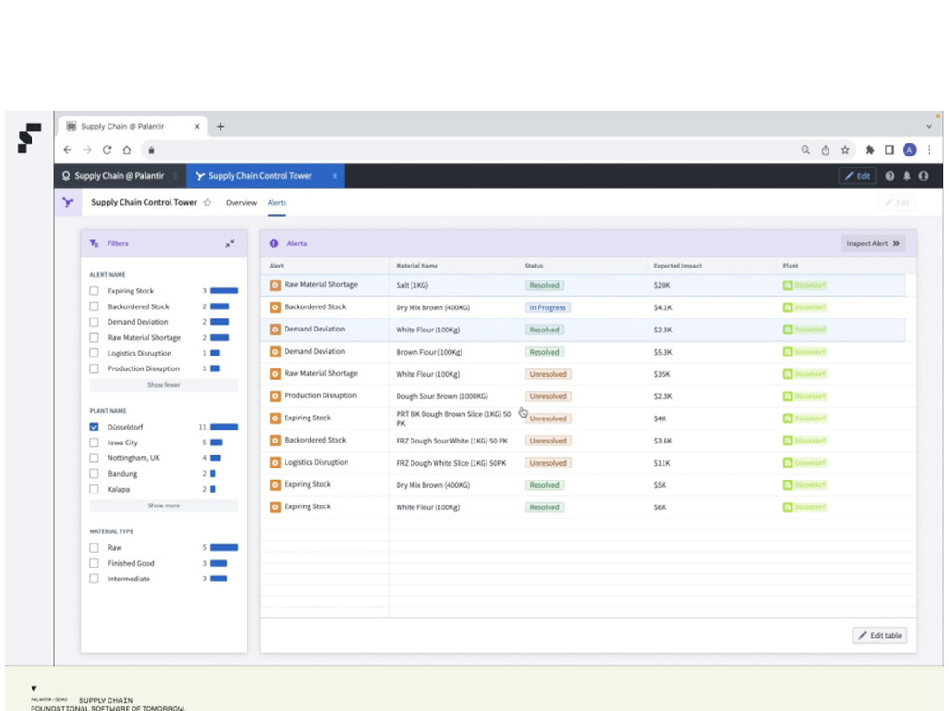
Scenario 1 | C-check readiness and critical spares
Accenture | Palantir
Notes:
Screen reference: original demo frame 0052
Talk track:
This is the alert workbench for planners.
Alerts are prioritised by operational impact: delay risk, cost, and safety-criticality.
Example alert types for STE: 'Critical part shortfall for Work Package', 'Repairable TAT breach', 'Aircraft arrival slipped, PO hold candidate', 'Tooling or certification gap'.
Planners triage, assign, and start an investigation with one click.

Slide 8
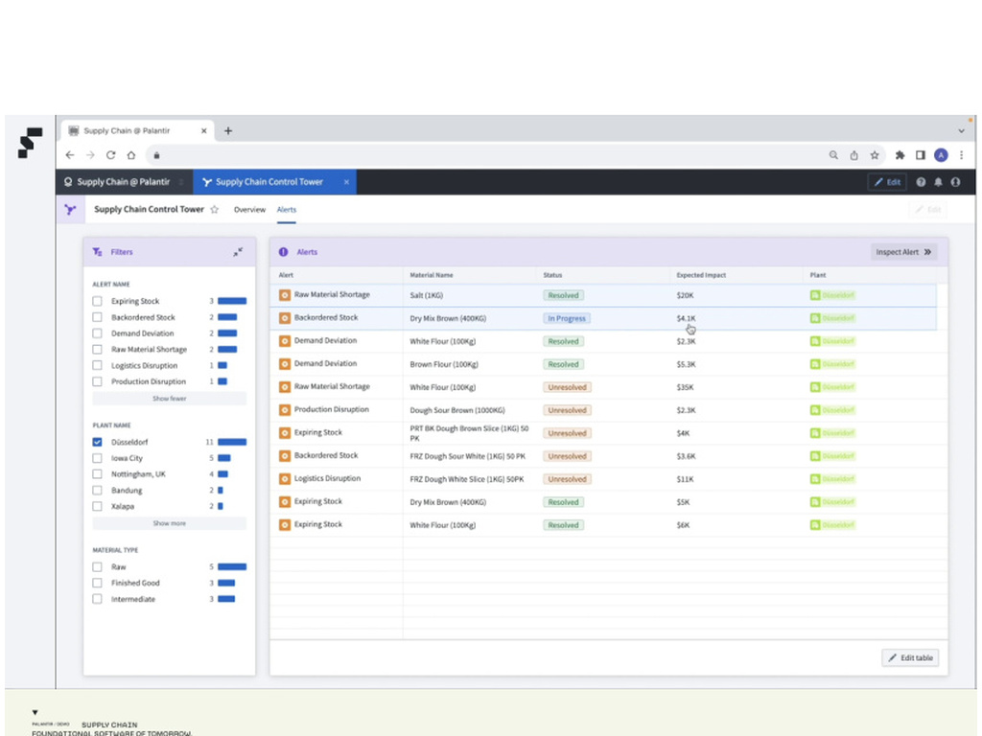
Scenario 1 | C-check readiness and critical spares
Accenture | Palantir
Notes:
Screen reference: original demo frame 0060
Talk track:
This is the alert workbench for planners.
Alerts are prioritised by operational impact: delay risk, cost, and safety-criticality.
Example alert types for STE: 'Critical part shortfall for Work Package', 'Repairable TAT breach', 'Aircraft arrival slipped, PO hold candidate', 'Tooling or certification gap'.
Planners triage, assign, and start an investigation with one click.

Slide 9
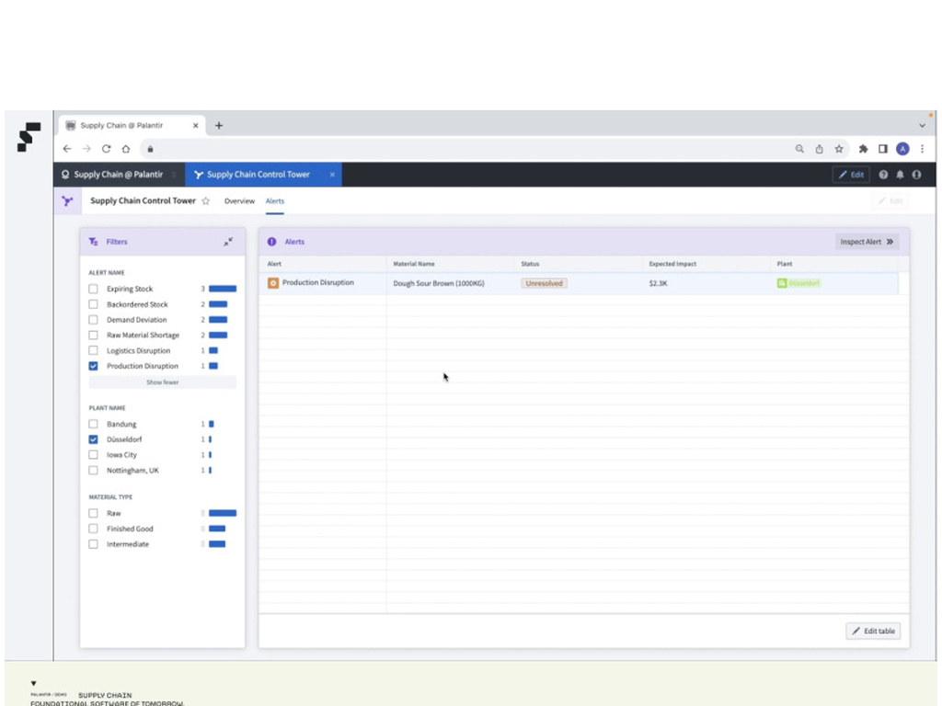
Scenario 1 | C-check readiness and critical spares
Accenture | Palantir
Notes:
Screen reference: original demo frame 0065
Talk track:
This is the alert workbench for planners.
Alerts are prioritised by operational impact: delay risk, cost, and safety-criticality.
Example alert types for STE: 'Critical part shortfall for Work Package', 'Repairable TAT breach', 'Aircraft arrival slipped, PO hold candidate', 'Tooling or certification gap'.
Planners triage, assign, and start an investigation with one click.

Slide 10
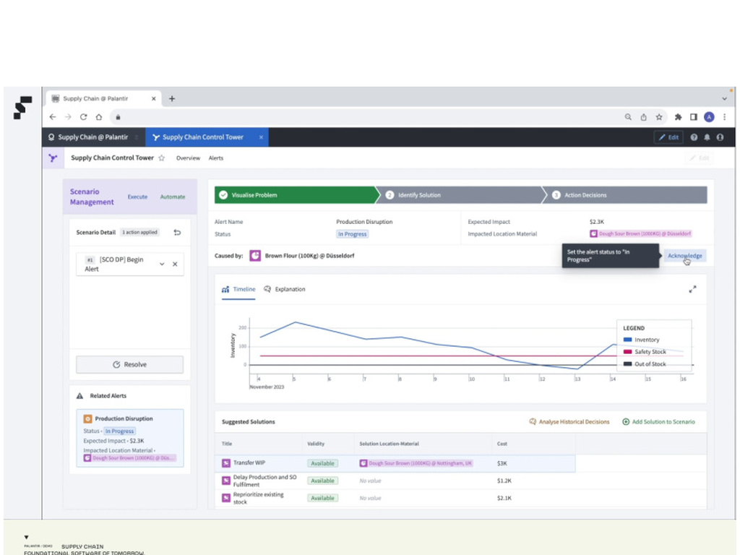
Scenario 1 | C-check readiness and critical spares
Accenture | Palantir
Notes:
Screen reference: original demo frame 0081
Talk track:
We open one alert: 'C-check for Tail 9V-XXX at Hangar 3 has a red part at Day-5'.
The system explains the root cause using a causal graph across demand, inventory, repair orders, and inbound shipments.
This is where heuristics and constrained optimisation can plug in for slot and material decisions.

Slide 11
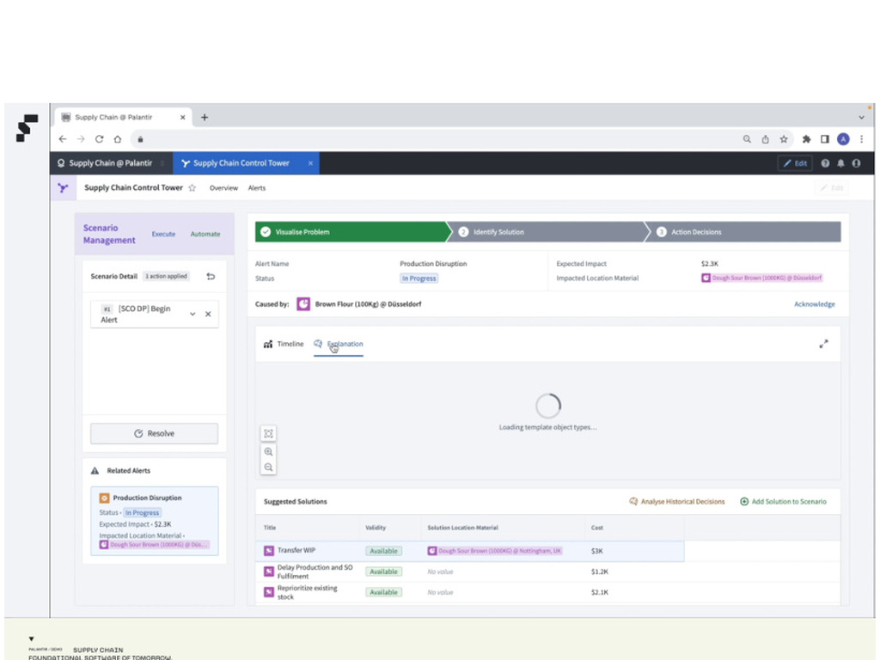
Scenario 1 | C-check readiness and critical spares
Accenture | Palantir
Notes:
Screen reference: original demo frame 0091
Talk track:
We open one alert: 'C-check for Tail 9V-XXX at Hangar 3 has a red part at Day-5'.
The system explains the root cause using a causal graph across demand, inventory, repair orders, and inbound shipments.
This is where heuristics and constrained optimisation can plug in for slot and material decisions.

Slide 12
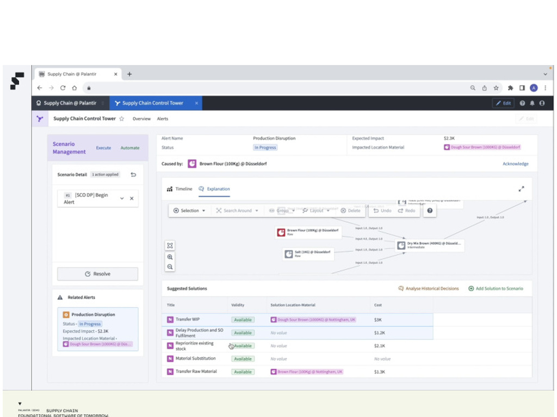
Scenario 1 | C-check readiness and critical spares
Accenture | Palantir
Notes:
Screen reference: original demo frame 0103
Talk track:
Now we simulate resolution options.
Options might include: transfer a rotable from another pool, expedite a repair, swap with a non-critical event, approve an alternate part, or borrow from an airline.
Each option shows impact on redelivery date, cost, and knock-on effects to other checks.
The decision owner is clear. For example: material planner proposes, hangar ops approves, finance reviews expedite cost threshold.

Slide 13
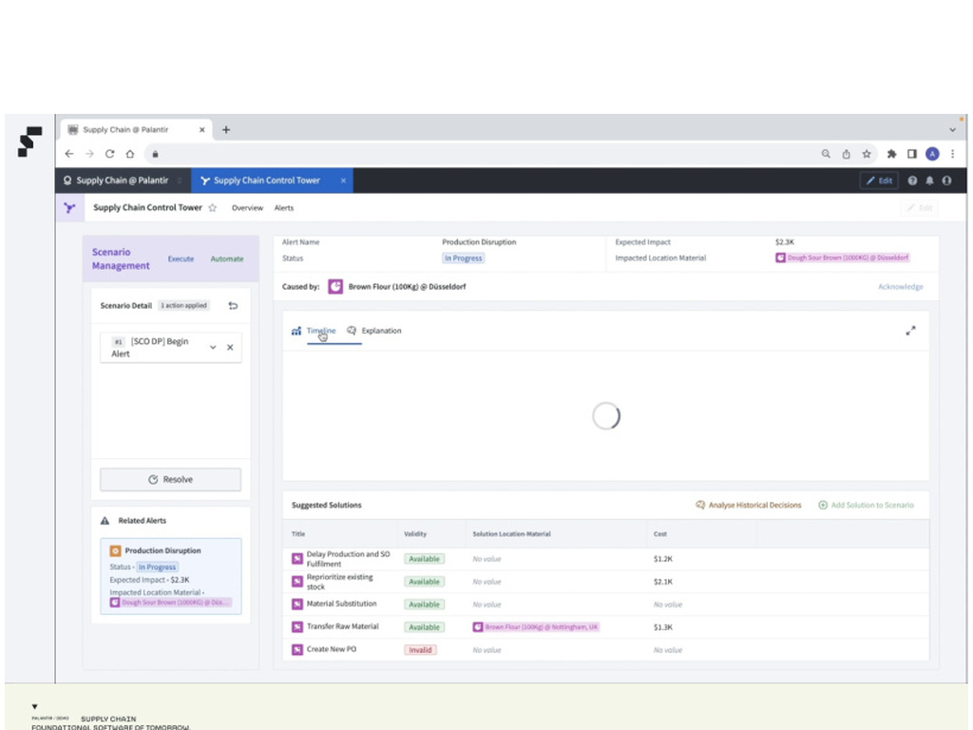
Scenario 1 | C-check readiness and critical spares
Accenture | Palantir
Notes:
Screen reference: original demo frame 0109
Talk track:
Now we simulate resolution options.
Options might include: transfer a rotable from another pool, expedite a repair, swap with a non-critical event, approve an alternate part, or borrow from an airline.
Each option shows impact on redelivery date, cost, and knock-on effects to other checks.
The decision owner is clear. For example: material planner proposes, hangar ops approves, finance reviews expedite cost threshold.

Slide 14
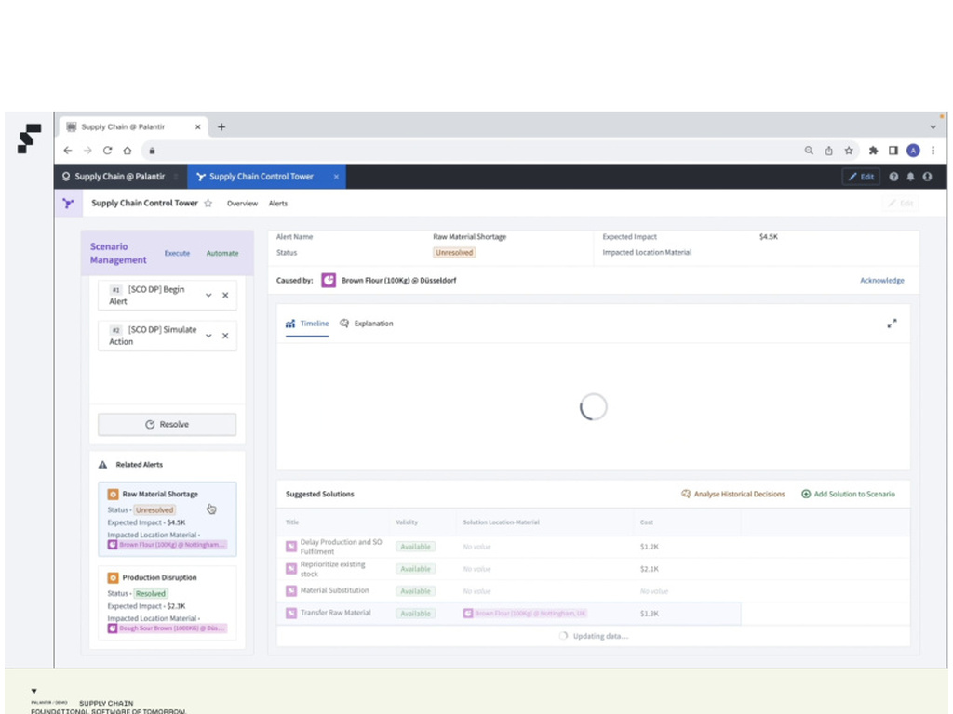
Scenario 1 | C-check readiness and critical spares
Accenture | Palantir
Notes:
Screen reference: original demo frame 0142
Talk track:
Now we simulate resolution options.
Options might include: transfer a rotable from another pool, expedite a repair, swap with a non-critical event, approve an alternate part, or borrow from an airline.
Each option shows impact on redelivery date, cost, and knock-on effects to other checks.
The decision owner is clear. For example: material planner proposes, hangar ops approves, finance reviews expedite cost threshold.

Slide 15
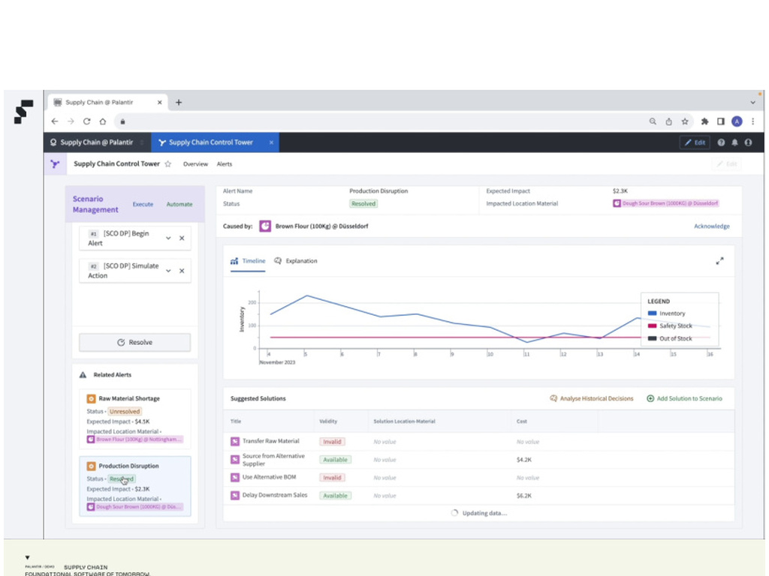
Scenario 2 | Component Services and MBH revenue assurance
Accenture | Palantir
Notes:
Screen reference: original demo frame 0151
Talk track:
Scenario 2 begins with component services and MBH revenue assurance.
We show a contract-backed view of component pools, service events, and expected flying-hours driven demand.
The goal is to move Excel-based rules into governed logic, and close gaps between flying hours, component consumption, and billing.

Slide 16
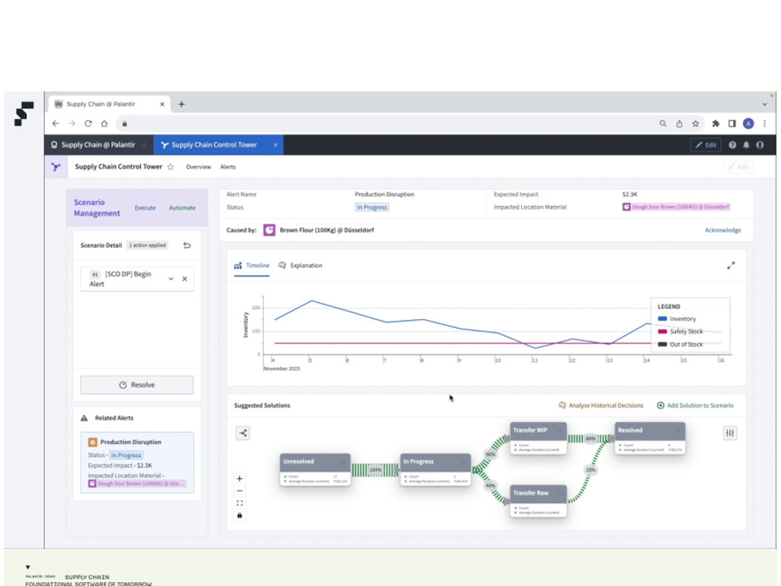
Scenario 2 | Component Services and MBH revenue assurance
Accenture | Palantir
Notes:
Screen reference: original demo frame 0165
Talk track:
Here we demonstrate an end-to-end 'exception to action' flow for component pools.
Example exception: a high-value rotable will go AOG at an outstation in 7 days unless we reposition stock.
The action graph proposes transfers and repair prioritisation. AIP can propose the best action given constraints.
When the action is chosen, the system generates the SAP transactions and tracks fulfilment.

Slide 17
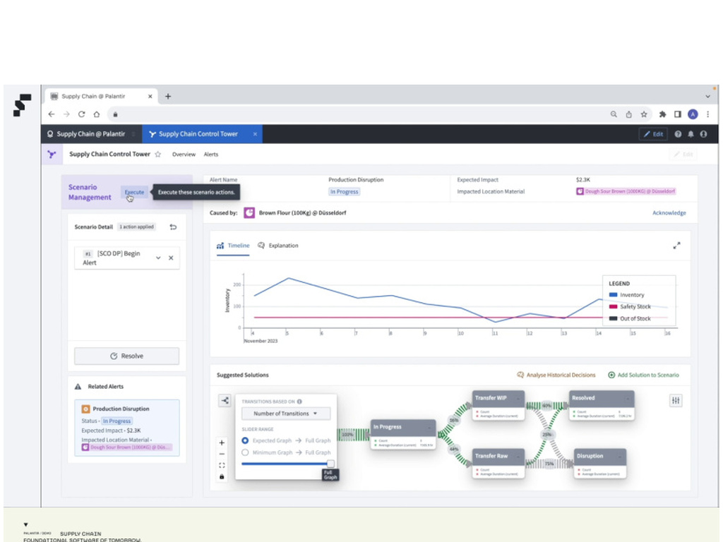
Scenario 2 | Component Services and MBH revenue assurance
Accenture | Palantir
Notes:
Screen reference: original demo frame 0169
Talk track:
Here we demonstrate an end-to-end 'exception to action' flow for component pools.
Example exception: a high-value rotable will go AOG at an outstation in 7 days unless we reposition stock.
The action graph proposes transfers and repair prioritisation. AIP can propose the best action given constraints.
When the action is chosen, the system generates the SAP transactions and tracks fulfilment.

Slide 18
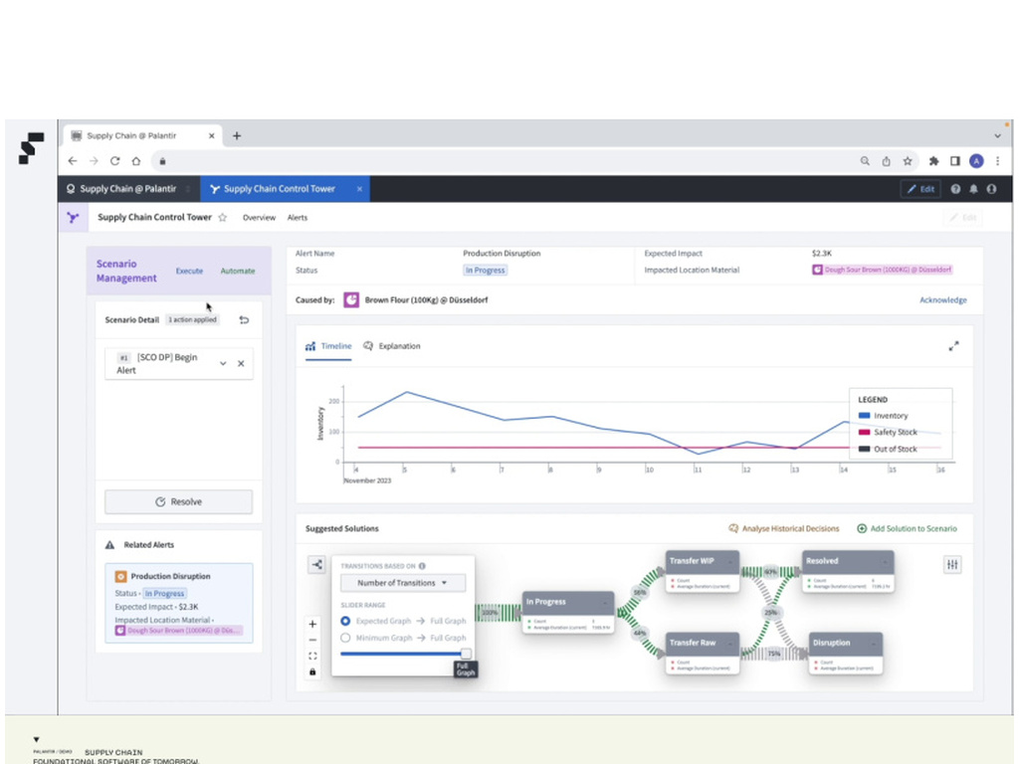
Scenario 2 | Component Services and MBH revenue assurance
Accenture | Palantir
Notes:
Screen reference: original demo frame 0170
Talk track:
Here we demonstrate an end-to-end 'exception to action' flow for component pools.
Example exception: a high-value rotable will go AOG at an outstation in 7 days unless we reposition stock.
The action graph proposes transfers and repair prioritisation. AIP can propose the best action given constraints.
When the action is chosen, the system generates the SAP transactions and tracks fulfilment.

Slide 19
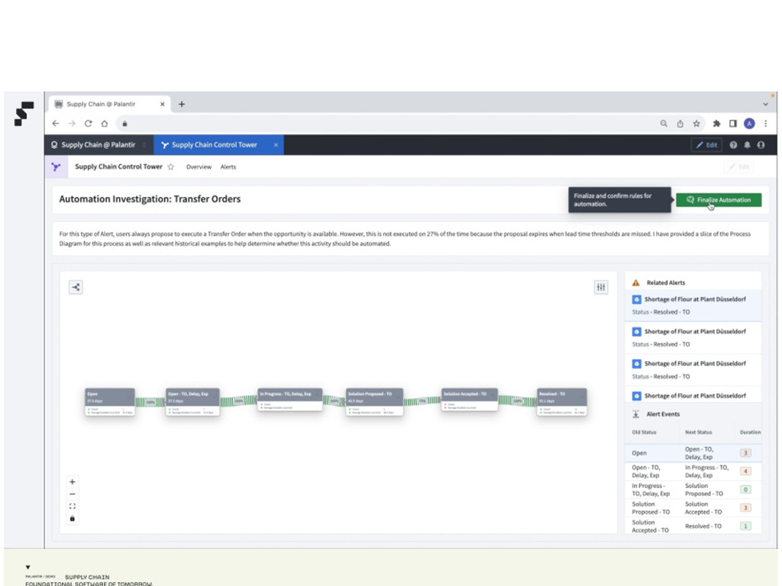
Scenario 2 | Component Services and MBH revenue assurance
Accenture | Palantir
Notes:
Screen reference: original demo frame 0181
Talk track:
We operationalise repeatable decisions with automation.
Example: 'When aircraft delivery slips by >48h, automatically recommend PO hold for parts not yet picked, and create an approval task.'
Controls: approval thresholds, segregation of duties, and a full audit trail of why a recommendation was made and what was executed in SAP.

Slide 20

Scenario 2 | Component Services and MBH revenue assurance
Accenture | Palantir
Notes:
Screen reference: original demo frame 0186
Talk track:
We operationalise repeatable decisions with automation.
Example: 'When aircraft delivery slips by >48h, automatically recommend PO hold for parts not yet picked, and create an approval task.'
Controls: approval thresholds, segregation of duties, and a full audit trail of why a recommendation was made and what was executed in SAP.

